Slide 1
Introduction to CUDA
Presented by: Anfal Alyousufi
Date: November 10, 2020

Slide 2
Agenda
Gordon Moore and Moore’s law
“Golden Rule”
Transistors
Multi-Core
Co-processor
CPU vs GPU
Pipelining
Demo

Slide 3
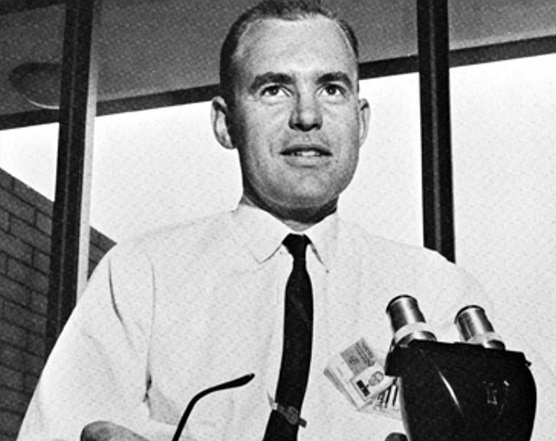
Gordon Moore
While serving as the director of research and development at Fairchild Semiconductor, he developed Moore’s Law. he went on to co-found the Intel Corporation.
Notes:
Have you noticed the faster technology gets, the cheaper it gets?
It all comes down to this guy, Gordon Moore, and a prediction he had made over 50 years ago that became a driving force of technological innovation.
It is called “Moore’s Law, not to be confused with Murphy’s Law, which is all about things going wrong, Moore’s Law is kind of the opposite it is about how everything gets better and better.

Slide 4
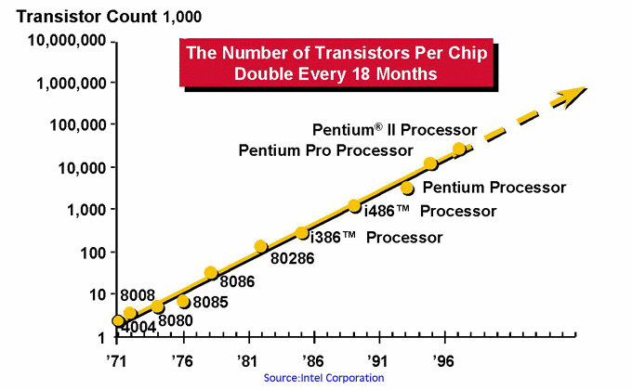
Moore’s Law
“The complexity for minimum component costs has increased at a rate of roughly a factor or two per year.”
“Certainly over the short term this rate can be expected to continue, if not to increase. Over the longer term, the rate of increase is a bit more uncertain, although there is no reason to believe it will not remain nearly constant for at least 10 years.”
Electronics, Volume 38, Number 8, April 19, 1965
Notes:
The simplest explanation of Moore’s Law is this: The power of computers will roughly double every two years.

Slide 5





Technology:
Notes:
So, tech will continue to get smaller, faster, and more reliable at a consistent rate while the relative cost goes down.

Slide 6


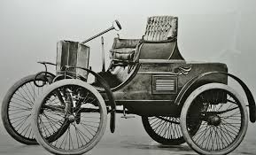






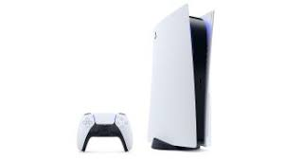
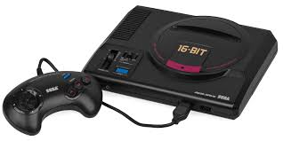
1965
“Golden rule”
Notes:
Moore made this prediction way back in 1965, saying it would lead to inventions like home computers, digital wristwatches, personal portable communication equipment.
CLICK
While many may say that Moore’s Law is dead, it was a kind of “golden rule” for the electronics industry for half a century, making life better for the end consumer, taking our lives from this to this.

Slide 7
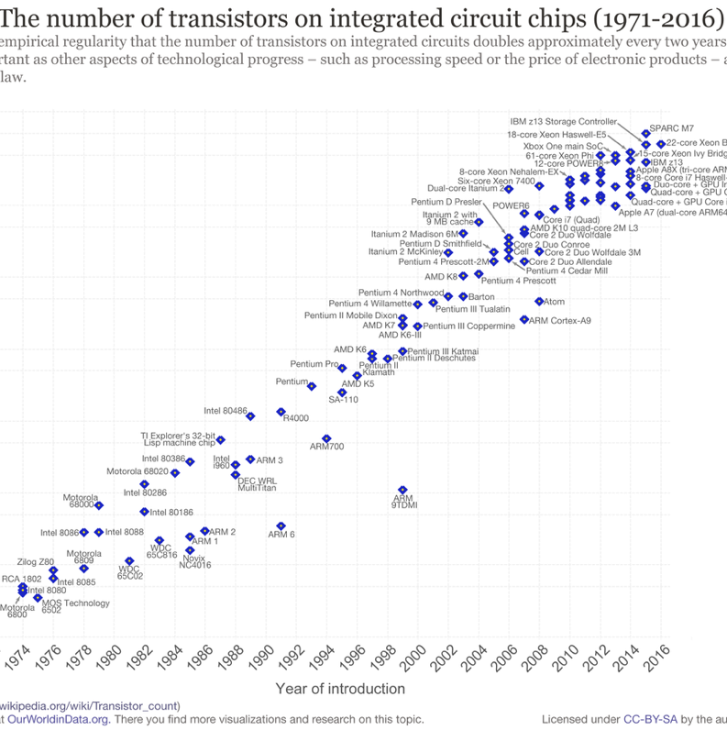
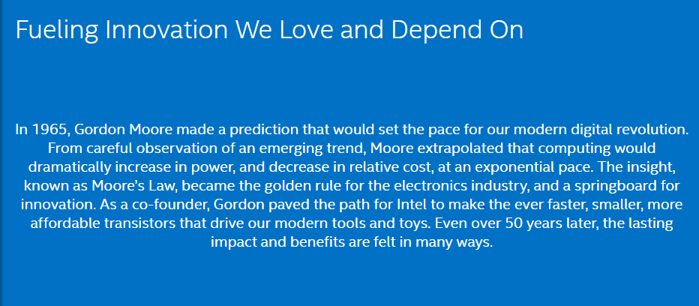
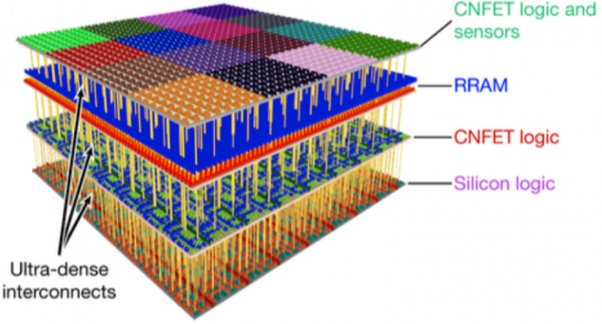
Moore’s Law is Dead? Or Not?
https://www.intel.com/content/www/us/en/silicon-innovations/moores-law-technology.html
Notes:
What is Moore’s law in simple terms?
So basically if you read Intel’s page on Moore’s Law they have a little mini website over 50 year of Moore law. What he basically said was Moore extrapolated that computing would dramatically increase in power(they mean performance there), and decrease in relative costs, at an exponential pace”. And of course this was at the era of the beginning of integrated circuits.
CLICK
So, what Gordon Moore was saying in his own words: “Integrated Circuits are the road to less expensive electronics.
And if we look the trend over the years of course the performance has gone up long long way and the price have come down. In fact, today’s processors are at least probably much more now THREE AND A HALF THOUSAND times faster than the original Intel 4004 microprocessor. 90 THOUSAND times more efficient and the price per transistor is 60,000 times lower. So we can see that integrated circuits have provided a way of lowering the cost and increasing the performance of consumer electronics.
CLICK –Graph-
We have a graph showing the number of transistors inside the integrated circuit starting back in the 1970s. The intel 4004 and then clearly there is a direction of travel and this is a logarithmic graph. Notice how the scale changing on the left by putting a logarithmic scale we can see this clear growth here right up to the kind of modern day processors up here and I am sure that if we plotted the very very most modern ones it would go up even higher.
So there is a clear trend that overall historically from the 1970s right through to the 2018-2020 that we can see this growth of the number of transistors.

Slide 8
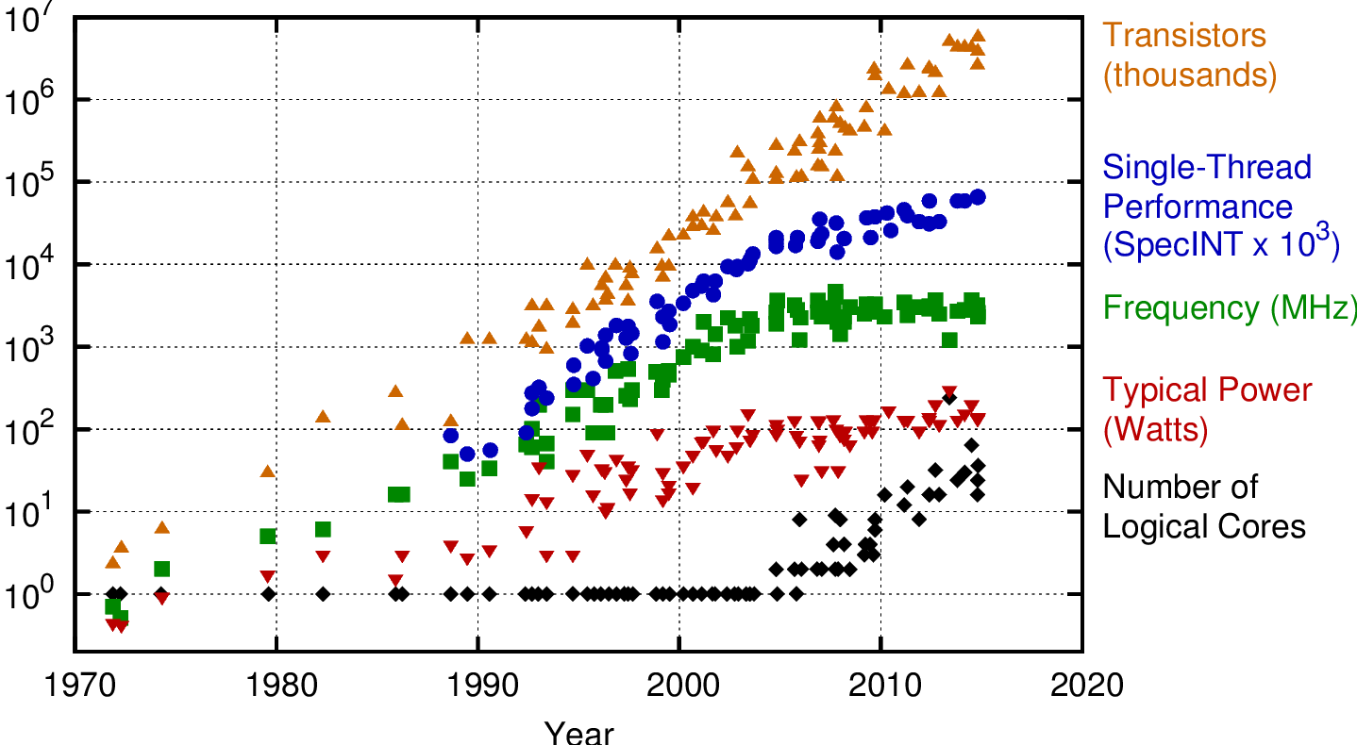
The True Story is ...
Notes:
so, if we make that into a more of a modern interpretation of course here we are in 2020 looking back at something he wrote in 1965.
Moore’s law is an observation and prediction that the number of transistors in an integrated circuit doubles about every two years.
it is one thing to notice here, we talk about Moore’s Law this is more in the sense of kind of you know Murphy’s law, it is not a law of physics as you can’t break Moore’s law like you are trying to break the law of gravity or break the speed of light. We are not trying to break a law of physics; Moore’s law is an observation and projection of a historical trend into the future.
It is not a law of physics it is an observation based on experience. When you hear people saying Moore’s law is dead but not saying that something has happened in science that means that this fundamental understanding of the way electronics works all the way you know integrates so that was it broken because it died now. This is actually just about a trend of how we are using silicon chips and how we are using transistors in those and how we are doubling the number of chips over the years.
---------]
Accordning to Robert H, Dennard;s 1974 paper said that:
if the transistor density doubles, the circuit becomes 40% faster, and power consumption( with twice the number of transistors) stays the same.
So this is really really important, so as we have been able to generate smaller and smaller transistors and put more and more transistors on an integrated circuit, what actually happens is that they get faster but the power consumption stays the same.
So, when we couple that with Moore’s law we can see that we can build faster and faster processors and chips with more and more transistors in them and actually with the power doesn’t go up and each generation they get faster.
CLICK
BUT! The problem is this got broken from about 2006 onwards, you know smartphones, laptops, PCs we have got 3 gigahertz and some of them might turbo boost to 4 gigahertz or whatever the latest bit of fashion is, but we don’t have 8GHz processors because there is a limit to this Dennard’s scale. However, when we do increase the density, we still benefit from the lower power consumption the transistors themselves fit switch faster because there are smaller transistors and of course we are able to use extra transistors to do more things in logic branch predictors than caching and they are always kind of stuff that we have nowadays. So we are still benefiting from some of these, but it is not as it was from when Dennard wrote it in 1974.
----
The funny thing is the Moore’s Law has died many time over the last 50 years as people have predicted the end of Moore’s law numerous times. As Robert Colwell, director of the Microsystems technology office at Defense Advanced Research Projects Agency said in 2013, for the Defense Department, the year 2020 and 7 nanometers are the “last process technology node”.. And yet here we are having smartphones, laptops, PCs and so on with 5nm. So, it is really one shouldn’t predict the end of Moore’s law because we just don’t know what is round the corner

Slide 9
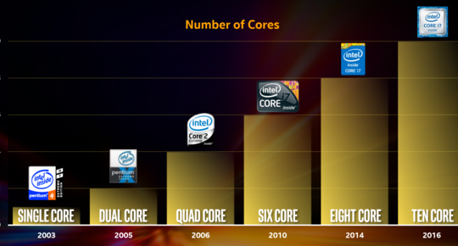
Multi-Core Age: Intel
Nvidia.com. Last Retrieved April 2, 2018
Notes:
Processor cores: are individual processing units within the computer’s central processing unit (CPU). The processor core would receive instruction from a single computing task, working with the clock speed to quickly process this information and temporarily store it in the Random Access Memory (RAM).
Hence, cores increase the amount of work accomplished at a time, whereas threads improve throughput, computational speed-up. Cores is an actual hardware component whereas thread is a virtual component that manages the tasks. Cores use content switching while thread use multiple CPUs for operating numerous processes.
The main issue with single core: mainly 2 issues
To execute the tasks faster, you need to increase the clock time
Increasing clock time would increase the power consumption and heat to an extremely high level, which makes the processor inefficient
Solution provided by multicore
Creating two or more core on the same die to increase the processing power while it also keeps clock speed at an efficient level
A processor with 2 cores running an efficient speed can process instructions with similar speed to the single-core processor. Its clock speed is twice, yet the multicore process consumes less energy.
https://www.guru99.com/cpu-core-multicore-thread.html

Slide 10
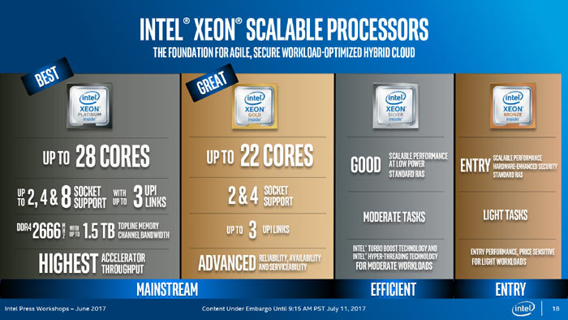
Multi-Core Today
Hexus.net, April 8, 2018

Slide 11

Other Players
https://www.engadget.com/2017/05/17/amd-s-16-core-threadripper-cpu-is-built-for-ultra-high-end-pcs/, April 8, 2018
Notes:
The extra processor cores offered by Ryzen compared to Intel’s Kaby and Coffee Lake CPUs means that certain tasks will run MUCH faster. If you do a lot of 3D rendering/video encoding or any of your favorite games run better on multiple cores (few do, but some popular titles like Battlefield 1 and Civ are included in the short-but-growing list) then the extra money is well worth paying. The extra cores can also help with video game streaming on services like Twitch.

Slide 12

And Co-Processors
Intel Phi Co-processors
Graphics Processing Units (GPU)
AMD APUs
Notes:
A co-processors is an extra processor used to supplement the functions of the primary processor which ofcourse this is (the CPU). It maybe used to perform a floating-point arithmetic, graphics processing and other functions.
It normally caries a limited range of processor

Slide 13
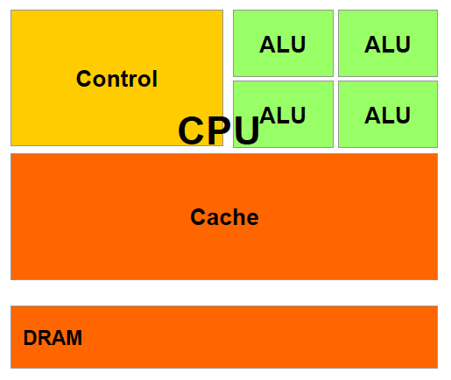
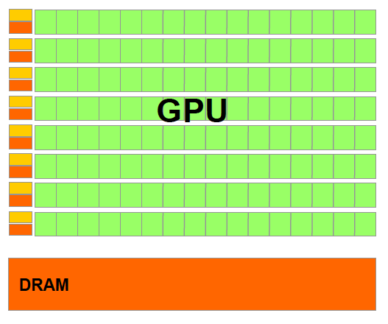
CPU vs. GPU Design
From Kirk and Hwu, 2012
Latency-oriented
Pipelining, out-of-order execution, speculation, special instructions
All such mechanisms consume power and area
Throughput-oriented
Data parallelism
Thread parallelism
Thin cores – low clock rate
Notes:
The main difference between CPU and GPU architecture is that a CPU is designed to handle a wide-range of tasks quickly (as measured by CPU clock speed), but are limited in the concurrency of tasks that can be running. A GPU is designed to quickly render high-resolution images and video concurrently.

Slide 14
Sample Assembly Code
.top
mov di,num1+digits-1
mov si,num2+digits-1
mov cx,digits ;
call AddNumbers ; num2 += num1
mov bp,num2 ;
call PrintLine ;
dec dword [term] ; decrement loop counter
jz .done ;
mov di,num2+digits-1
mov si,num1+digits-1
mov cx,digits ;
call AddNumbers ; num1 += num2
.bottom
mov bp,num1 ;
call PrintLine ;
dec dword [term] ; decrement loop counter
jnz .top ;
.done
call CRLF ; finish off with CRLF
mov ax,4c00h ; terminate
int 21h ;
main:
mov ax,'00' ; initialize to all ASCII zeroes
mov di,counter ; including the counter
mov cx,digits+cntDigits/2 ; two bytes at a time
cld ; initialize from low to high memory
rep stosw ; write the data
inc ax ; make sure ASCII zero is in al
mov [num1 + digits - 1],al ; last digit is one
mov [num2 + digits - 1],al ;
mov [counter + cntDigits - 1],al
jmp .bottom ; done with initialization, so begin

Slide 15
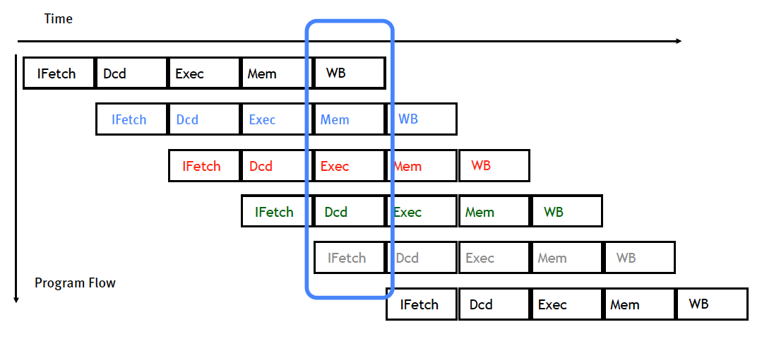
Instruction Parallelism: Pipelining
Diagram is from John Owens
Notes:
Pipelining is an implementation technique where multiple instructions are overlapped in execution. The computer pipeline is divided in stages. Each stage completes a part of an instruction in parallel.

Slide 16
CPU Thread Support
Main Memory
Cache
Cache
Cache
Cache
A few processors each supporting one hardware thread
On-chip cache (up to a few MBs)
Directly addressing shared external main memory (normally DDR4)

Slide 17
GPU Thread Support
Global memory
Cache
Cache
Cache
Main memory
Cache
Thousands of processors supporting many hardware threads
On-chip cache (up to a few MBs)
Directly addressing shared external memory (DDR5 or HBM2)
Can also address the main memory of the host machine (DDR4)

Slide 18
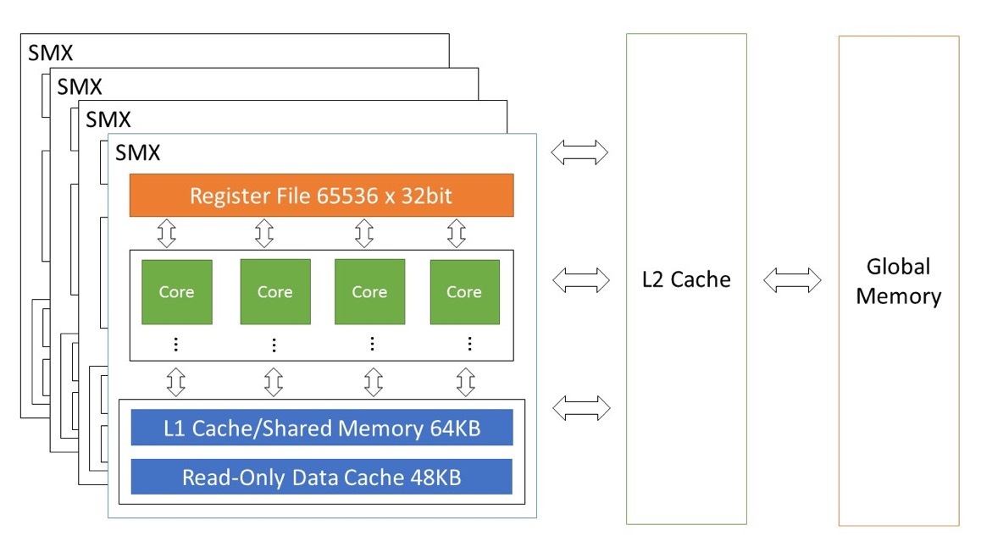
GPU Architecture

Slide 19

The Looks of A GPU
Nvidia.com. Last Retrieved April 2, 2018

Slide 20
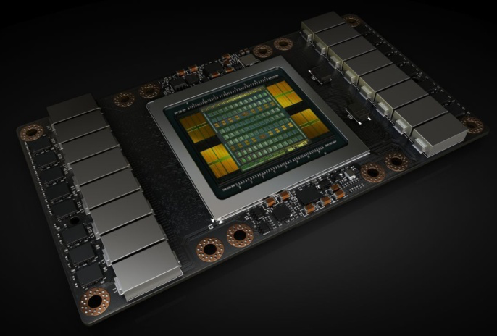
A Look Inside the Box
Nvidia.com. Last Retrieved April 2, 2018

Slide 21
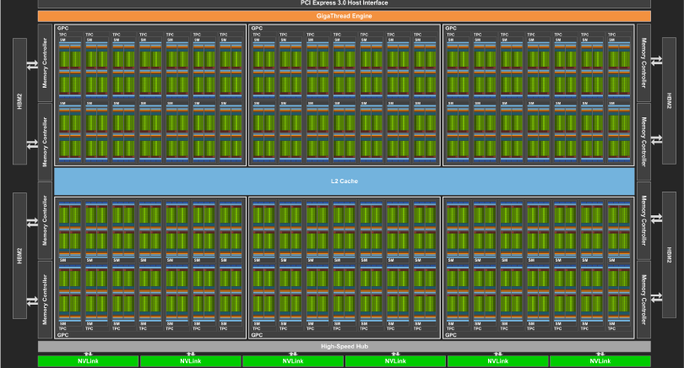
TESLA V100 Architecture
Luke Durant and Olivier Giroux. Inside Volta. The 2017 GPU Technology Conference, San Jose, CA. May 8, 2017.
Notes:
NVIDIA® V100 Tensor Core is the most advanced data center GPU ever built to accelerate AI, high performance computing (HPC), data science and graphics. It's powered by NVIDIA Volta architecture, comes in 16 and 32GB configurations, and offers the performance of up to 32 CPUs in a single GPU.

Slide 22
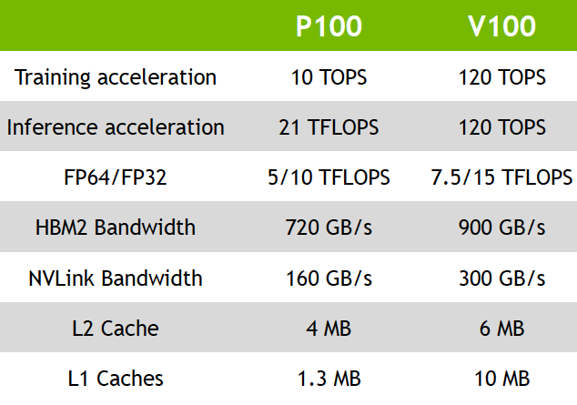
Pascal/Volta Specifications
Luke Durant and Olivier Giroux. Inside Volta. The 2017 GPU Technology Conference, San Jose, CA. May 8, 2017.

Slide 23
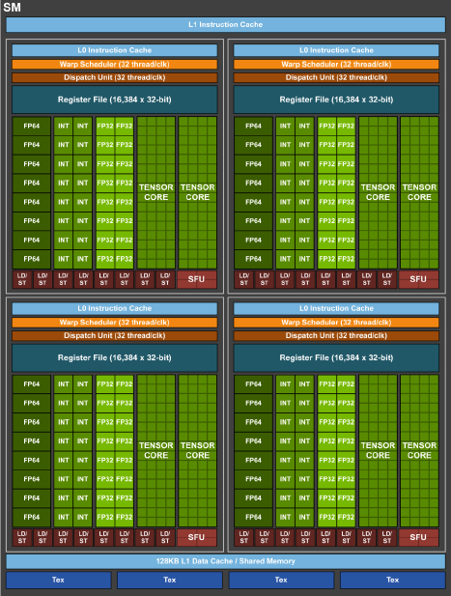
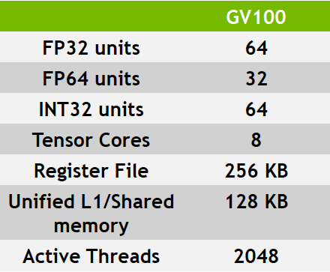
Volta GV100 SM
Luke Durant and Olivier Giroux. Inside Volta. The 2017 GPU Technology Conference, San Jose, CA. May 8, 2017.

Slide 24
GPU Computing Power

Slide 25
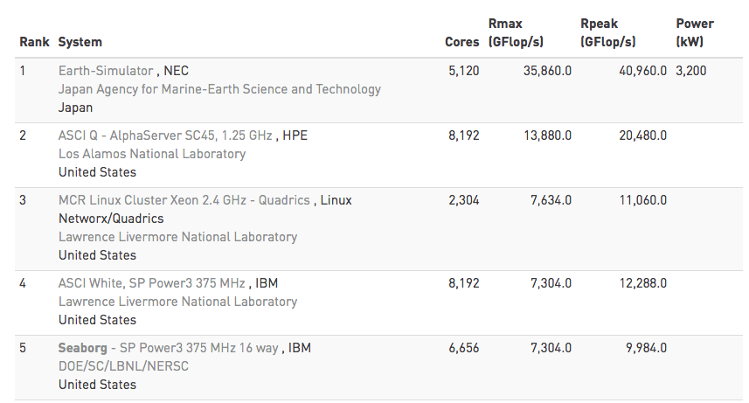
TOP 500 List – June 2003

Slide 26

Earth-Simulator
640 nodes
5120 processors
10TB memory
700 TB disk space
320 cabinets
3200kw
http://www.jamstec.go.jp/ceist/e/es/ and Wiki

Slide 27
GPU Memory Bandwidth

Slide 28





900GB is ...
9 UltraHD 4K movies
30 blue-ray movies
260,000 songs in MP3
300,000 pictures
40 computer games
Pictures and icons are from the Internet

Slide 29
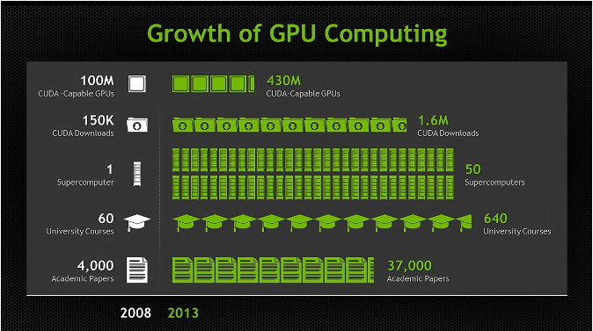
Popularity of GPU computing
Content is from NVIDIA

Slide 30
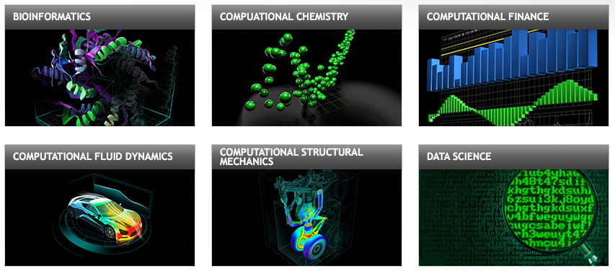
Application Domains of GPGPU
Nvidia.com. Retrieved April 8, 2018

Slide 31
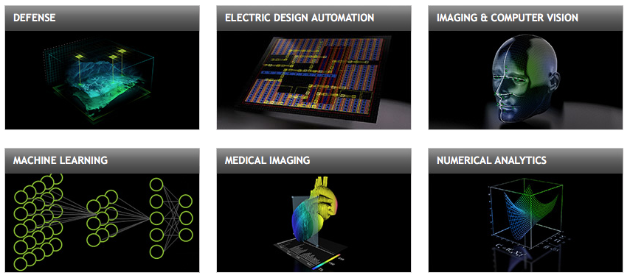
Application Domains of GPGPU
Ever heard of Blockchain?
Nvidia.com. Retrieved April 8, 2018
Notes:
A blockchain is a mesh network of computers linked not to a central server but rather to each other. Computers in this network define and agree upon a shared state of data and adhere to certain constraints imposed upon this data.

Slide 32


GPGPU: Programming a GPU
OpenCL(Open Computing Language)
Framework for heterogeneous computing
Open standard
Maintained by Khronos Group
Support many hardware types
CUDA (Compute Unified Device Architecture)
Framework for CPU+GPU computing
Closed system
Maintained by NVidia
Support only Nvidia GPUs

Slide 33
GPU architecture basics
Stream Multiprocessors (SM)
GPU processors (cores)
Registers
Cache
Shared memory
L1 Cache
Read-Only data cache
Texture memory
Onboard (L2) cache
Global memory
High bandwidth, long latency
Getting better over the years
Connects to host via PCI-E
High-speed NVLink

Slide 34
Memory Hierarchy
Register
Register
Cache
SM Cache
Main Memory
L2 Cache
SSDs
Global Memory
Hard Disks
Main (Host) Memory
Tertiary Storage (Optical, Tape,...)

Slide 35
CUDA Programmer’s View of GPU Memories
Two-level thread organization
Grid – block – thread
A thread has its own register set (1 cycle)
A block is bound to an SMX with its shared memory (20 cycles)
Everything in the grid can access global memory (~500 cycles)
Kirk & Hwu, ECE408/CS483/ECE498al class notes

Slide 36
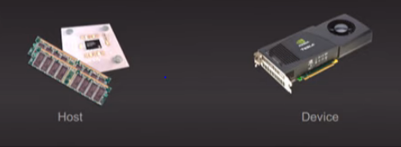
Heterogeneous Computing
Terminology:
Host: The CPU and its memory (host memory)
Device: The GPU and its memory (device memory)
Notes:
It is called a device because you could have an OpenCL device and you can have FPGA accelerator
This is a co-processor

Slide 37
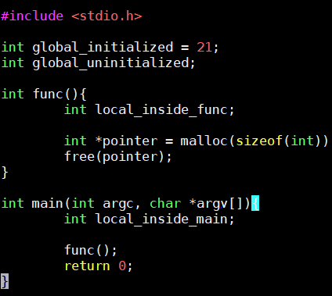

Memory Layout of C/C++ Programs
Stack
Command Line Arguments
Argv[0]
Argv[1]
Argv[n]
main()
local_inside_main
local_inside_func
func()
pointer
Heap
int
global_uninitialized
Uninitialized Variables
a.out
global_initialized(21)
Initialized Variable
Text Segment
Notes:
How is this specific program laid out in a memory when you compile the program and try to run, you will generate a a.out in a linux environment and when you do ./a.out the program will start executing.
Hence, let us see when it starts executing how does the memory looks like:
So, When you compile this program, the first thing that happens is you create a.out in a linux environment

Slide 38
How I connect to GPU cards
CSE has 20 nodes that have recent GPU’s installed in them, which are available via the “devgpu” partition. Which I used to compile and run my CUDA program
Load the CUDA module on the node I assigned:
There is an executable name deviceQuery that we can run which will tell you all about the card

Slide 39
Compiling a CUDA program
1) Open a new document and write your program and save it with .cu extension
2) compile it with:
nvcc [file_name.cu]-o [output_executable_filename]
nvcc test.cu -o test
3) Run CUDA program:
./output_executable_filename

Slide 40

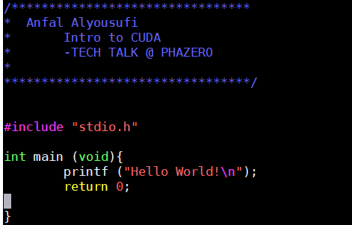
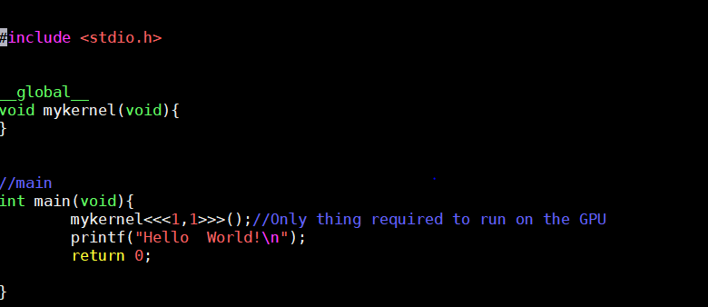
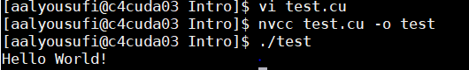
“Hello world”
Notes:
Standard C runs in the host.
The only difference between this hello word and usual C++ hello world it is that we are not going to compile it with GCC we are going to compile it with nvcc

Slide 41
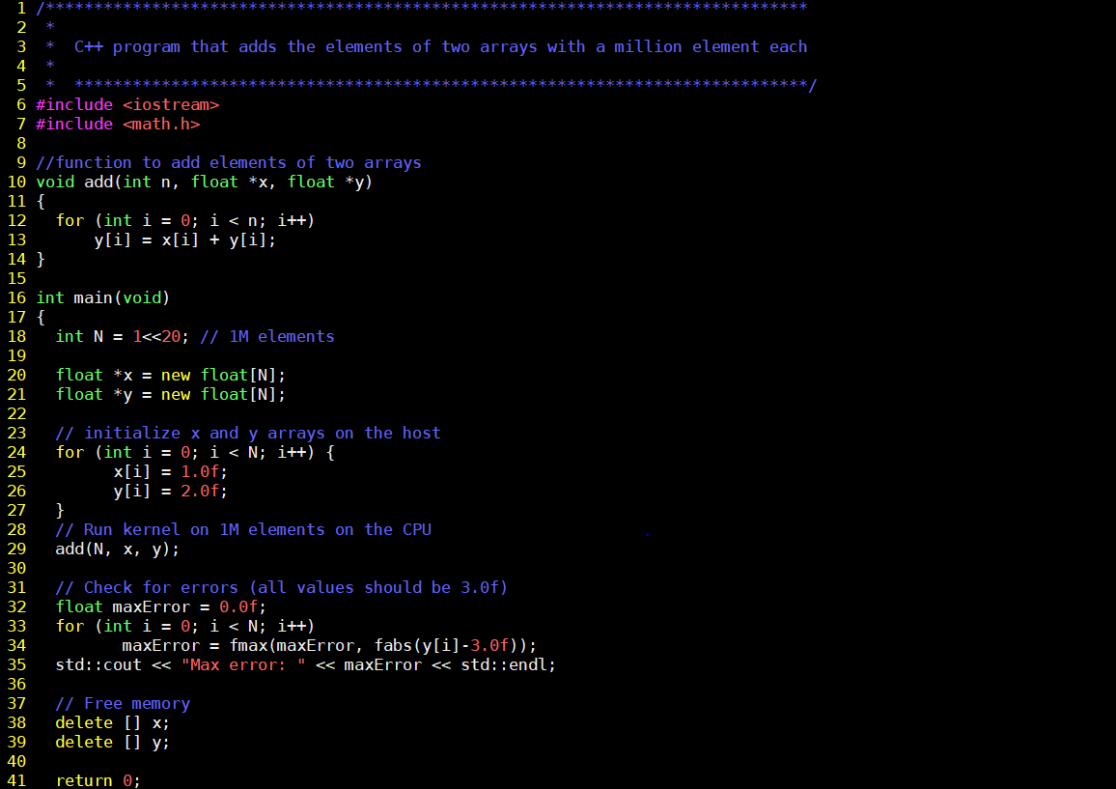
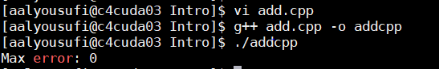

Slide 42
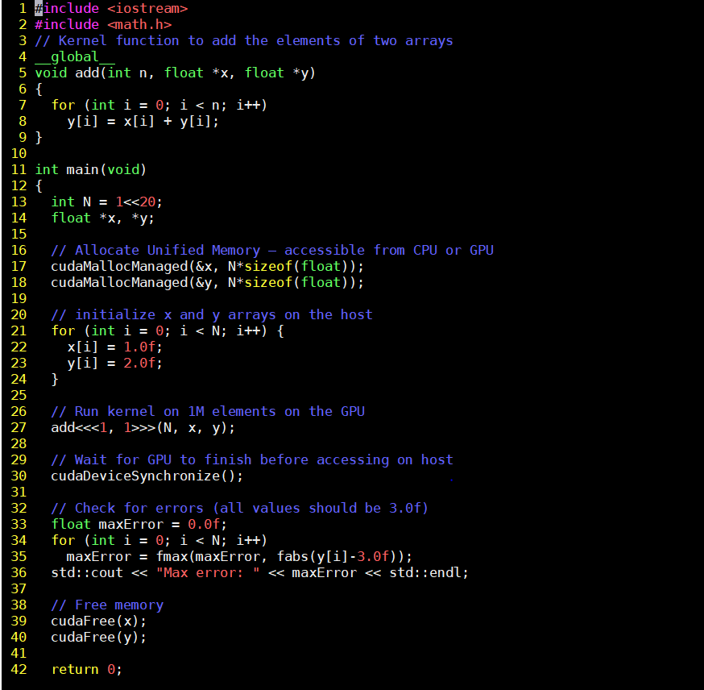

Slide 43
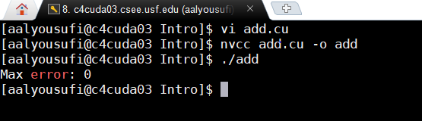
Output

Slide 44
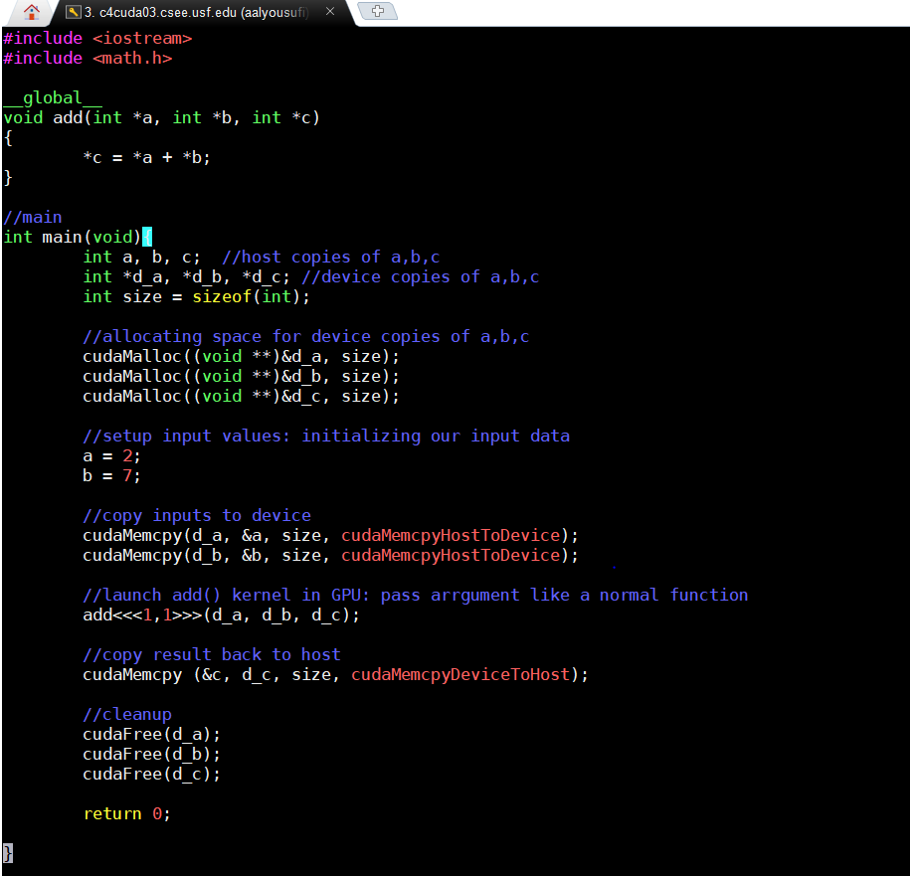
Addition
Given the heterogeneous nature of the CUDA programming model, a typical sequence of operations for a CUDA C program is:
Declare and allocate host and device memory.
Initialize host data.
Transfer data from the host to the device.
Execute one or more kernels.
Transfer results from the device to the host.

Slide 45
Summary
Moore’s Law hits a power wall
GPU is a leading platform of many-core computing
Many fields adopt GPU
Parallel coding on GPUs – lucrative yet tricky business
Demo

Slide 46



Slide 47
[Thank you]
Any questions?

